Slide 1
ATM Machine Case Study
An In depth Analysis of ATM Systems

Slide 2
Overview:
An Automated Teller Machine (ATM) is a computerized telecommunications device that provides access to financial transactions in a public space without the need for a human cashier. ATMs are used for a variety of banking transactions, including cash withdrawals, deposits, account transfers, balance inquiries, and bill payments.

Slide 3
Key Components of an ATM
Hardware Components:
Card Reader
Keypad
Display Screen
Cash Dispenser
Deposit Slot
Receipt Printer
Network Connection
Software Components:
Operating System
Application Software
Security Software
rd Reader
Key
ypad
Display Screen
Cash Dispenser
Deposit Slot
Receipt Printer
Network Connection
Software Components:
Operating System
Application Software
Security Software

Slide 4
Functional Requirements
Authentication:
Validate the user by reading the card information and PIN.
Implement multi-factor authentication for enhanced security.
Transaction Processing:
Cash withdrawals, balance inquiries, deposits, and fund transfers.
Update the bank database in real-time to reflect transactions.
User Interface:
Provide clear instructions and feedback to the user through the display screen.
Offer multiple language options.
Security:
Encrypt data transmission between the ATM and the bank's server.
Secure the hardware to prevent tampering.
Implement fraud detection mechanisms.
Functional Requirements
Authentication:
Validate the user by reading the card information and PIN.
Implement multi-factor authentication for enhanced security.
Transaction Processing:
Cash withdrawals, balance inquiries, deposits, and fund transfers.
Update the bank database in real-time to reflect transactions.
User Interface:
Provide clear instructions and feedback to the user through the display screen.
Offer multiple language options.
Security:
Encrypt data transmission between the ATM and the bank's server.
Secure the hardware to prevent tampering.
Implement fraud detection mechanisms

Slide 5
Non-Functional Requirements
Reliability:
Ensure high availability and uptime.
Regular maintenance and monitoring.
Performance:
Fast transaction processing times.
Efficient handling of concurrent transactions.
Usability:
User-friendly interface.
Accessible design for users with disabilities.
Scalability:
Support for an increasing number of transactions and users.
Ability to add new features and services.
Compliance:
Adherence to banking regulations and standards.
Regular audits and security assessments.
Non-Functional Requirements
Reliability:
Ensure high availability and uptime.
Regular maintenance and monitoring.
Performance:
Fast transaction processing times.
Efficient handling of concurrent transactions.
Usability:
User-friendly interface.
Accessible design for users with disabilities.
Scalability:
Support for an increasing number of transactions and users.
Ability to add new features and services.
Compliance:
Adherence to banking regulations and standards.
Regular audits and security assessments.

Slide 6
Use Case Scenarios
Cash Withdrawal:
User inserts the ATM card.
The system prompts the user to enter their PIN.
User selects the withdrawal option and enters the amount.
The system verifies the user's balance and dispenses cash.
The system prints a receipt and updates the user's account balance.
Balance Inquiry:
User inserts the ATM card and enters the PIN.
User selects the balance inquiry option.
The system retrieves and displays the account balance.
The system prints a receipt if requested.
Deposit:
User inserts the ATM card and enters the PIN.
User selects the deposit option.
The system prompts the user to insert cash or checks.
The system credits the user's account and prints a receipt.
Fund Transfer:
User inserts the ATM card and enters the PIN.
User selects the fund transfer option.
The system prompts the user to enter the recipient's account number and the transfer amount.
The system debits the user's account and credits the recipient's account.
The system prints a receipt.
Use Case Scenarios
Cash Withdrawal:
User inserts the ATM card.
The system prompts the user to enter their PIN.
User selects the withdrawal option and enters the amount.
The system verifies the user's balance and dispenses cash.
The system prints a receipt and updates the user's account balance.
Balance Inquiry:
User inserts the ATM card and enters the PIN.
User selects the balance inquiry option.
The system retrieves and displays the account balance.
The system prints a receipt if requested.
Deposit:
User inserts the ATM card and enters the PIN.
User selects the deposit option.
The system prompts the user to insert cash or checks.
The system credits the user's account and prints a receipt.
Fund Transfer:
User inserts the ATM card and enters the PIN.
User selects the fund transfer option.
The system prompts the user to enter the recipient's account number and the transfer amount.
The system debits the user's account and credits the recipient's account.
The system prints a receipt.

Slide 7
Security Considerations
Physical Security:
Install ATMs in secure locations with surveillance cameras.
Use tamper-evident seals and alarms.
Data Security:
Encrypt all data transmissions.
Use secure PIN entry devices.
Regularly update software to protect against vulnerabilities.
User Security:
Educate users about PIN safety and fraud prevention.
Implement transaction monitoring and alert systems.
Security Considerations
Physical Security:
Install ATMs in secure locations with surveillance cameras.
Use tamper-evident seals and alarms.
Data Security:
Encrypt all data transmissions.
Use secure PIN entry devices.
Regularly update software to protect against vulnerabilities.
User Security:
Educate users about PIN safety and fraud prevention.
Implement transaction monitoring and alert systems.

Slide 8
Challenges and Solutions
Fraud and Theft:
Challenge: Skimming devices and card cloning.
Solution: Use EMV chip technology and install anti-skimming devices.
Technical Failures:
Challenge: Hardware malfunctions and software bugs.
Solution: Regular maintenance, updates, and redundancy systems.
User Error:
Challenge: Incorrect PIN entries and transaction mistakes.
Solution: Provide clear instructions and user-friendly interfaces.
Network Issues:
Challenge: Connectivity problems and server downtime.
Solution: Use reliable network infrastructure and backup connections.
Challenges and Solutions
Fraud and Theft:
Challenge: Skimming devices and card cloning.
Solution: Use EMV chip technology and install anti-skimming devices.
Technical Failures:
Challenge: Hardware malfunctions and software bugs.
Solution: Regular maintenance, updates, and redundancy systems.
User Error:
Challenge: Incorrect PIN entries and transaction mistakes.
Solution: Provide clear instructions and user-friendly interfaces.
Network Issues:
Challenge: Connectivity problems and server downtime.
Solution: Use reliable network infrastructure and backup connections.

Slide 9
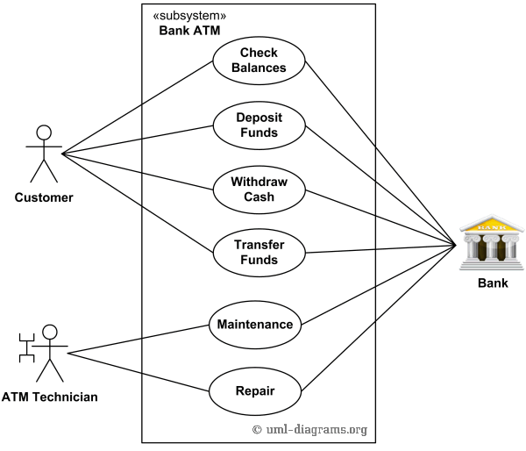
Use Case Diagram:
UML Diagrams
Use Case Diagram

Slide 10
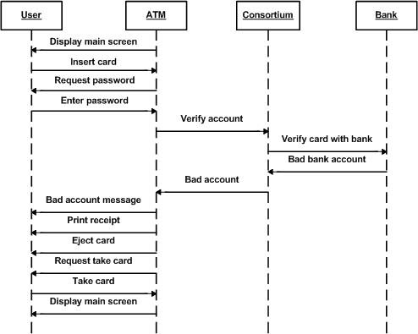
Sequence Diagram

Slide 11
Conclusion
ATMs are an essential part of modern banking, offering convenient and secure access to financial services. The design and operation of ATMs require a combination of reliable hardware, robust software, and stringent security measures to ensure a seamless user experience and protect against various threats. Continuous improvements in technology and security are necessary to meet the evolving needs of users and maintain trust in the ATM system.
Conclusion
ATMs are an essential part of modern banking, offering convenient and secure access to financial services. The design and operation of ATMs require a combination of reliable hardware, robust software, and stringent security measures to ensure a seamless user experience and protect against various threats. Continuous improvements in technology and security are necessary to meet the evolving needs of users and maintain trust in the ATM system.

